Slide 1

SQL Project: RCB - IPL Strategy
Submitted By:
Submitted by
Ayush Nandwana

Slide 2
Problem Statement
You are hired as a sport data analyst by RCB where the team is looking for top-performing and reliable players to win tournaments, considering both on-field performance and value for money in mega player auction of 2017.
Your task is to come up with strategies/suggestions regarding selecting the best-performing players and optimizing player auction investments.

Slide 3
Objective
To analyze IPL player performance data and identify the most reliable, high-impact players for RCB. The goal is to build a competitive, well-balanced squad while maximizing value in the mega auction.

Slide 4
Data Description
Ball_by_Ball
Match_id: Unique identifier for a cricket match
Over_id: Unique identifier for an over in a cricket match
Ball_id: Unique identifier for a ball in an over
Innings_No: The innings number in a cricket match
Team_Batting: The team batting in a particular innings
Team_Bowling: The team bowling in a particular innings
Striker_Batting_Position: The batting position of the striker batsman
Striker: The batsman currently on strike
Non_Striker: The batsman currently at the non-striker's end
Bowler: The bowler bowling the current delivery
Batting_style​
​
Batting_id: Unique identifier for a batsman's batting record​
Batting_hand: The batting hand (right or left) of a batsman​
Bowling_style​
​
Bowling_id: Unique identifier for a bowler's bowling record​
Bowling_skill: The bowling skill (e.g., right-arm fast, left-arm spin) of a bowler​
City​
​
City_id: Unique identifier for a city​
​
City_Name: The name of a city​
​
Country_id: Unique identifier for a country​

Slide 5
Data Description
Matches
Match_Id: Unique identifier for each match.
Match_Date: The date when the match took place.
Match_Winner: The team that won the match.
Outcome_Type: Type of result (win, tie, etc.).
Toss_Winner: The team that won the toss.
Win_Type: The method by which the match was won (e.g., runs or wickets).
Win_Margin: The margin by which the match was won.
Venue_Id: Reference to the venue where the match was played.
Season_Id: The season in which the match occurred.
Venue
Venue_Id: Unique identifier for each venue.
Venue_Name: Name of the venue.
City_Id: Reference to the city where the venue is located.
Country
Country_Id: Unique identifier for each country.
Country_Name: Name of the country.
Player Match
Match_Id: Reference to the match in which the player participated.
Player_Id: Reference to the player.
Role_Id: Role of the player (e.g., batsman, bowler).
Team_Id: Team that the player represented in the match.
Wickets Taken
Ball_Id: Reference to the specific ball during which the wicket was taken.
Fielder: Reference to the player who fielded the ball.
Bowler: Reference to the bowler who took the wicket.
Player_Out: Reference to the player who was dismissed.

Slide 6
Data Description
.Extra Type
Extra_Type_Id: Unique identifier for the type of extra runs scored in a cricket match.
Extra_Runs: The number of extra runs scored in a particular delivery.
Innings_No: The innings number in a cricket match.
Extra_Id: Unique identifier for an instance of extra runs scored.
Extra_Name: The name or description of the type of extra runs scored (e.g., byes, leg byes, wides, no-balls).
Season
Season_Id: Unique identifier for a particular season or tournament.
Venue_Id: Unique identifier for the venue or stadium where the match is played.
Win_By
Win_Type: The type of win (e.g., runs, wickets) achieved by the winning team.
Win_Margin: The margin of victory (e.g., runs or wickets) for the winning team.
Outcome
Outcome_type: The type of outcome or result of the match (e.g., win, loss, tie, no result).
Match_Winner: The team that won the match.
Man_of_the_Match: The player awarded the Man of the Match award.
Out_Type
Out_Id: Unique identifier for the type of dismissal or way a batsman got out.
Out_Name: The name or description of the type of dismissal (e.g., caught, bowled, lbw, run out).
Outcome_Id: Unique identifier for the outcome or result of a match.

Slide 7
Data Description
Rolee
Role_Id: Unique identifier for a player's role or skills (e.g., batsman, bowler, all-rounder).
Role_Desc: Description of a player's role or skills.
Man_of_the_Series: The player awarded the Man of the Series award for a particular tournament.
Orange_cap: The player awarded the Orange Cap (for most runs scored) in a particular tournament.
Purple_cap: The player awarded the Purple Cap (for most wickets taken) in a particular tournament.
Extra Runs
Ball_Id: Reference to the specific ball during which extra runs were conceded.
Extra_Type_Id: Type of extra run (e.g., wide,no-ball).
Innings_No: The innings number during which the extra run occurred.
Match_Id: Reference to the match in whichthe extra runs were conceded.
Umpire
Umpire_id: Unique identifier for an umpire officiating the match.
Umpire_name: The name of an umpire.
Umpire_country: The country or nationality of an umpire.
Toss Decision
Toss_Name: The name or description of the toss (e.g., heads or tails).
Player
Player_Id: Unique identifier for a player.
Player_Name: The name of a player.
Team
Team_Id: Unique identifier for a team.
Team_Name: The name of a team.

Slide 8
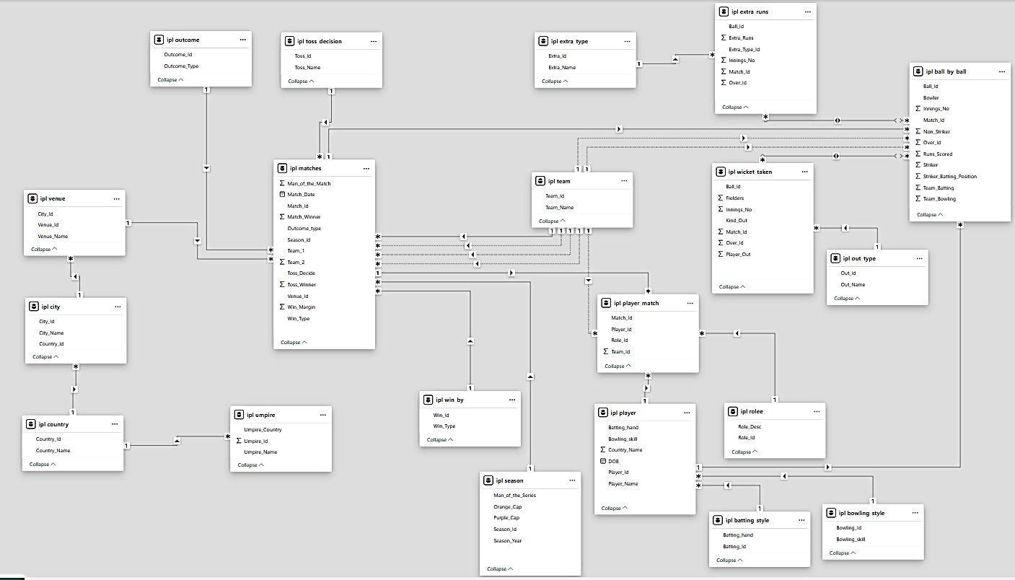
Database Schema

Slide 9
Methodology
1. Data Collection:
Extract historical IPL data (batting, bowling, fielding, match results, auction prices).
Clean and standardize datasets for player-wise aggregation.
2. Data Processing :(Calculate key metrics)
Batting: Avg, SR, Runs/Season, Boundary %, Consistency
Bowling: Economy, Avg, Strike Rate, Wickets/Season
All-rounder Index
Win Contribution %, Performance Impact Score
3. Performance Segmentation:
High Impact player
Consistent Performers
Undervalued Players
High-Risk Players

Slide 10
Methodology
4. Value-for-Money (VFM) Analysis:
Compare performance score vs. past auction price.
Identify cost-effective players.
5. Shortlisting & Recommendation:
Rank players using weighted scoring model.
Suggest ideal targets for RCB based on role, performance, and cost.

Slide 11
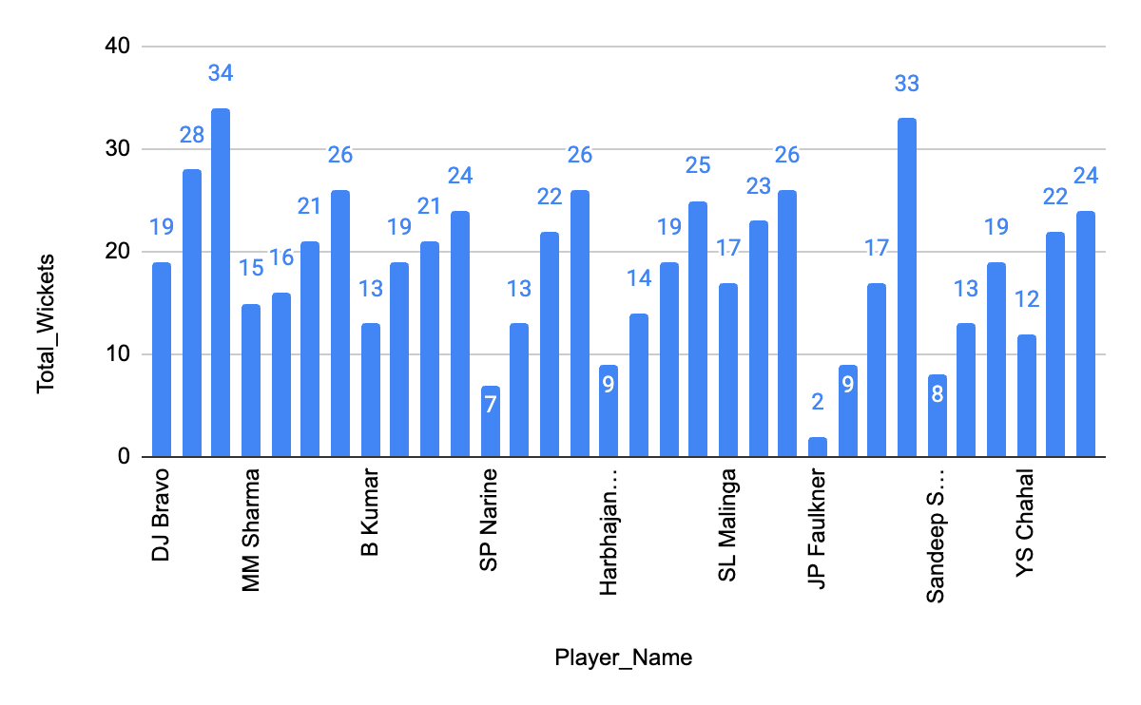
Wickets Taken per Season
Top Wicket-Takers by Season:
This query identifies the highest wicket-takers across each IPL season by aggregating total dismissals per bowler. It highlights bowlers with consistent match-winning impact. For RCB, such insights are crucial in evaluating past performers and targeting top wicket-takers for strengthening the bowling unit in upcoming auctions.

Slide 12
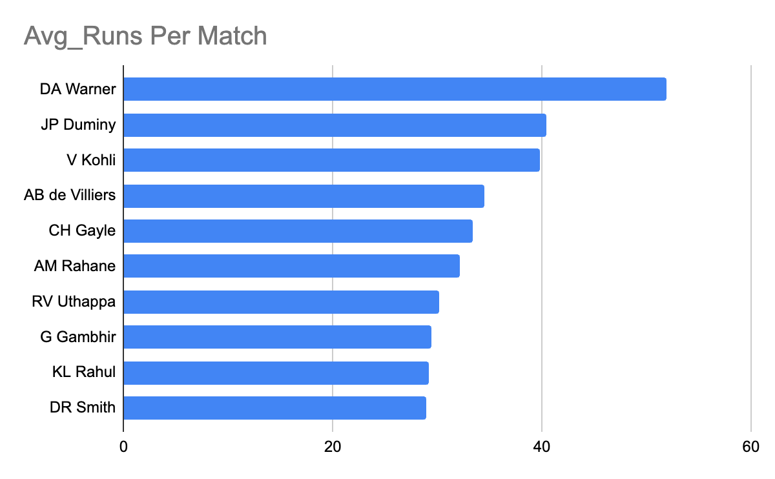
Runs scored per match
Average Runs per match:
This analysis evaluates RCB batsmen based on their average runs per match across all IPL seasons. It helps identify consistent performers who could be valuable assets in future auctions. Players with higher averages demonstrate reliability and the potential to anchor, innings making them strong contenders for retention or strategic bidding.
Batting Average = Total Runs / matches Played

Slide 13
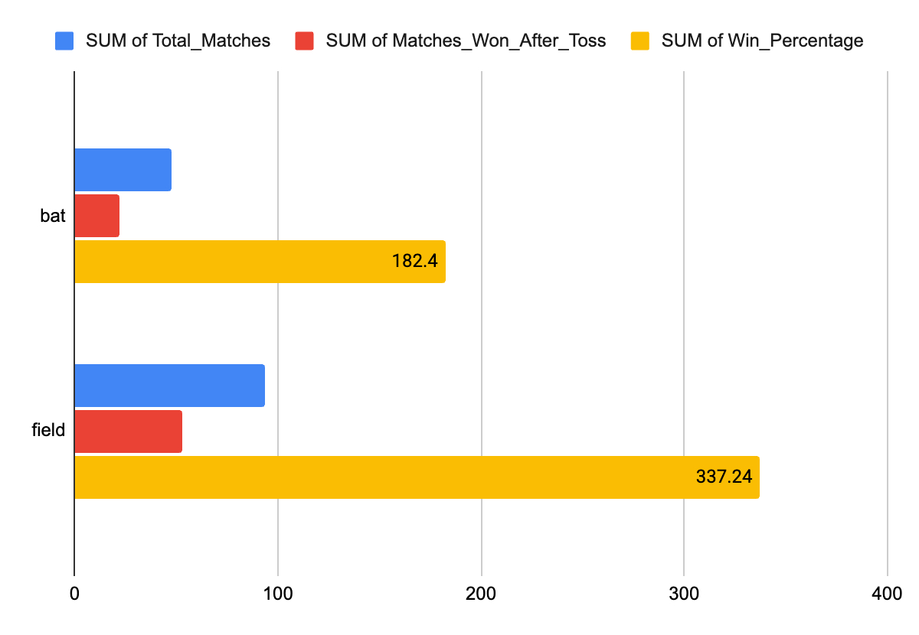
Toss Decision Impact
Impact of Toss Decision on Match Decision
This analyzes how toss decisions (bat or field first) influence match outcomes across different venues. It calculates the percentage of matches won by teams that won the toss. These insights help RCB optimize match-day strategies based on venue-specific trends and inform decisions during high-pressure toss moments.

Slide 14
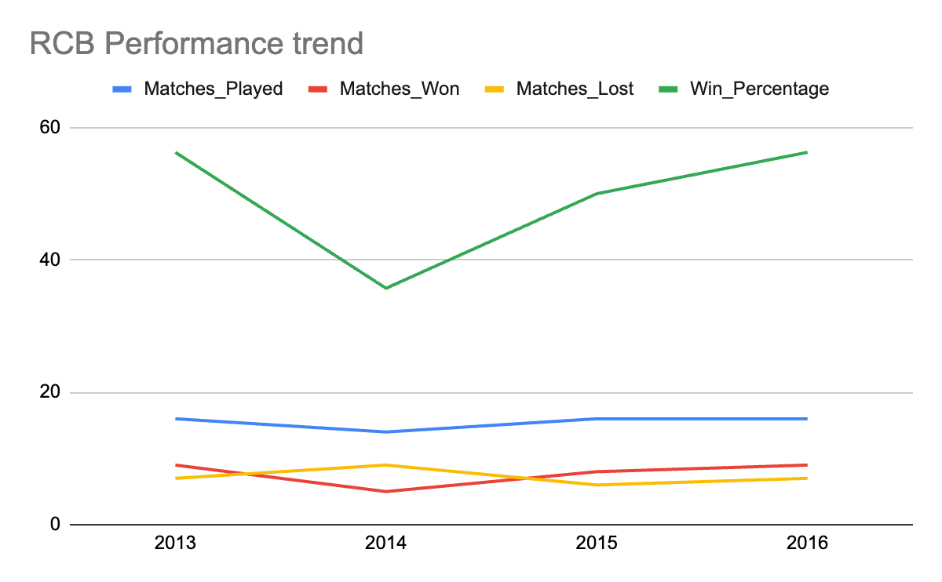
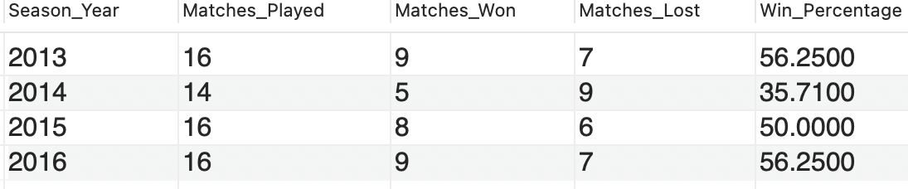
Team Insights: RCB Performance Analysis
RCB's Seasonal Performance Overview (2013–2016):
This analysis tracks RCB’s win percentage across IPL seasons from 2013 to 2016. The data reveals consistently average performance, with the highest win rate at just 56.25% in 2013 (9 wins in 16 matches) and 5 wins in 2014. Such underwhelming outcomes highlight the need for major strategic overhauls—particularly in team selection and leadership—when preparing for future auctions and squad rebuilding.

Slide 15
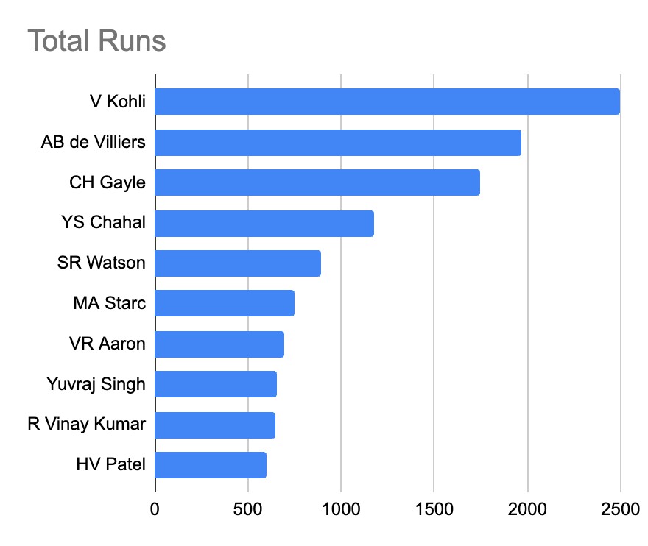
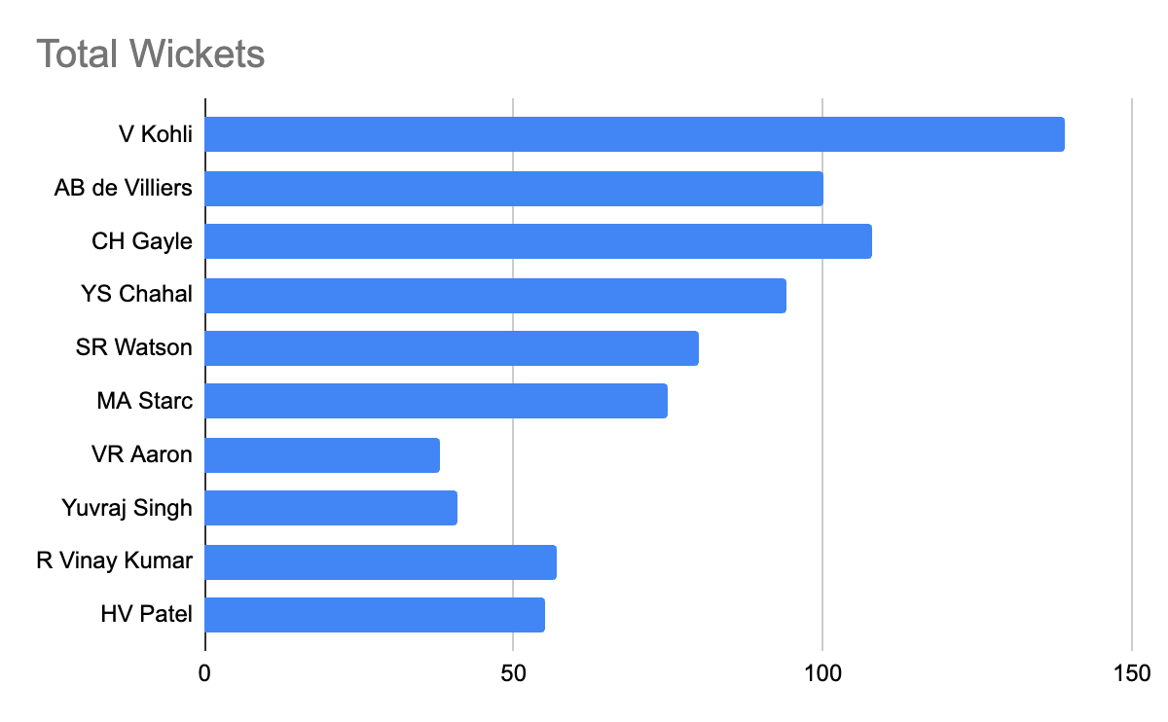
All – Rounder & Consistent Performers
Top All-Rounders
Players who have contributed significantly with both bat and ball are – S Watson, A Russell, K Pollard, J Kallis, Shakib Al Hasan.
These players can be classified as all-rounders and will provide balance to the team.
These players have batting average greater than overall batting average and wickets taken greater than overall wicket average.

Slide 16
Strategic KPIs for Team Success
1. Win Percentage
Measures overall success rate across seasons
(Matches Won / Matches Played) × 100
2. Average Runs per Match
Measures team's scoring consistency
Total Runs Scored / Total Matches Played
3. Average Wickets per Match
Shows bowling strength of team
Total Wickets Taken / Total Matches Played
4. Run Rate
Measures scoring speed across matches
Total Runs Scored / Total Overs Faced
5. Toss Impact KPI
Win % after toss decision (bat/field)
(Wins After Decision / Matches with That Decision) × 100

Slide 17
Data-driven Player Recommendations
Player Name | Total Runs (all Seasons)
Virat Kohli | 2472
DA Warner | 2348
AB de Villiers | 1968
RG Sharma | 1899
RV Uthappa | 1852
Player-wise Seasonal Batting Trends:
The season-wise batting performance highlights Virat Kohli as the top run-scorer with 2,472 runs, showcasing exceptional consistency across multiple seasons. Close behind, David Warner (2,348 runs) and AB de Villiers (1,968 runs) also demonstrated strong, reliable form. Rohit Sharma and Robin Uthappa, each crossing 1,800 runs, underline their value as experienced contributors. These trends not only spotlight key performers but also help identify stable batting pillars for future team planning and auction strategies.

Slide 18
Data-driven Player Recommendations
Player Name | Total Wickets (all Seasons)
DJ Bravo | 81
MM Sharma | 78
B Kumar | 77
SP Narine | 68
Harbhajan Singh | 67
Bowling Performance Insights Across Seasons:
The multi-season wicket trends reveal Dwayne Bravo as the most impactful bowler with 81 wickets, consistently performing across all four seasons. Mohit Sharma (78) and Bhuvneshwar Kumar (77) follow closely, showing strong year-on-year contributions. Sunil Narine and Harbhajan Singh, with 68 and 67 wickets respectively, demonstrate their long-term effectiveness. The visual progression highlights players like Bravo and Kumar sustaining peak form, making them critical bowling assets for any team’s strategy.

Slide 19
Key Findings & Conclusion
Key Data Insights
Top Performer Highlights
V. Kohli (39.87 avg), AB de Villiers, and DJ Bravo (81 wickets) stood out as consistent match-winners.
All-Rounder Impact Identified
Players like SR Watson (1315 runs, 54 wickets) and RA Jadeja (670 runs, 56 wickets) offer immense auction value.
Venue-Specific Trends Matter
RCB excels at M. Chinnaswamy (55.17%-win rate), but struggles at venues like Wankhede and Uppal.
Toss Decisions Drive Outcomes
Toss advantage evident at MA Chidambaram (72.73% win when batting first) – a key strategy factor.

Slide 20
Key Findings & Conclusion
Future-Ready Strategy Recommendations
Prioritize All-Rounders in Auctions:
Build a balanced squad with flexible options across departments.
Strengthen Bowling Attack:
Focus on death-overs and spin talent to reduce run leakage and boost wicket-taking consistency.
Adopt Venue-Based Squad Rotation:
Tailor lineups to pitch and performance history across stadiums.
Enhance Tactical Decisions Using Data:
Leverage win percentage, match-ups, and toss analysis to optimize on-field choices.
Integrate Advanced Analytics in Planning:
Prepare for real-time strategy tools, predictive modeling, and opposition-based planning as outlined in the roadmap.

Slide 21
THANK YOU

